Slide 1
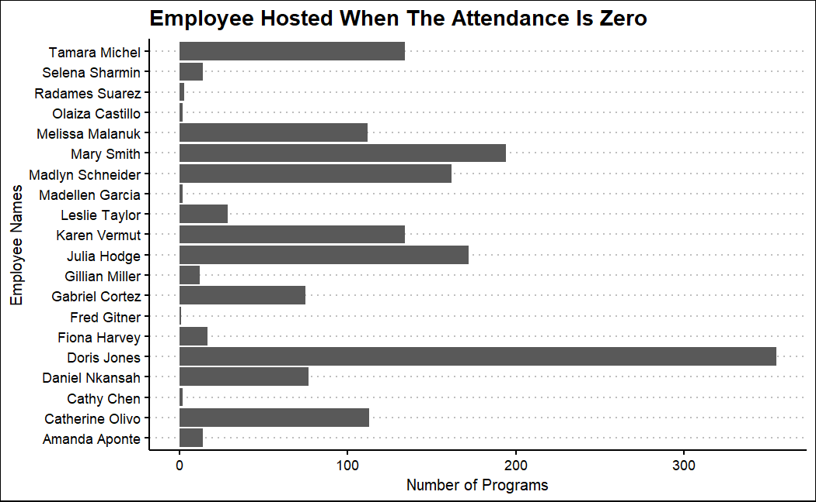
Were there any key takeaways from the programs with missing (0) attendance?
Doris Jones has the highest number of programs with zero attendance at 355.
QPL Staff | Number of Programs with zero attendance
Amanda Aponte | 14
Catherine Olivo | 113
Cathy Chen | 2
Daniel Nkansah | 77
Doris Jones | 355
Fiona Harvey | 17
Fred Gitner | 1
Gabriel Cortez | 75
Gillian Miller | 12
Julia Hodge | 172
Karen Vermut | 134
Leslie Taylor | 29
Madellen Garcia | 2
Madlyn Schneider | 162
Mary Smith | 194
Melissa Malanuk | 112
Olaiza Castillo | 2
Radames Suarez | 3
Selena Sharmin | 14
Tamara Michel | 134

Slide 2
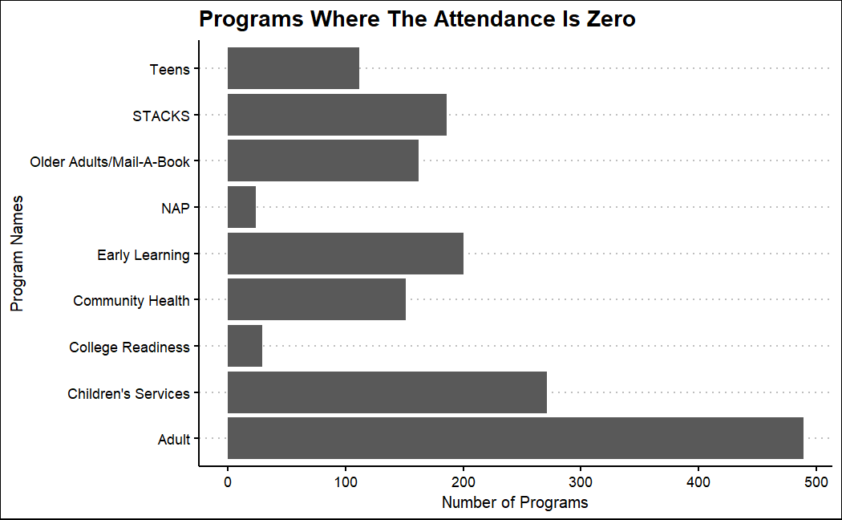
Were there any key takeaways from the programs with missing (0) attendance?
The Adult Programs has the highest amount of zero attendance with it being 489
Program | Number of Programs with zero attendance
Adult | 489
Children's Services | 271
College Readiness | 29
Community Health | 151
Early Learning | 200
NAP | 24
Older Adults/Mail-A-Book | 162
STACKS | 186
Teens | 112

Slide 3
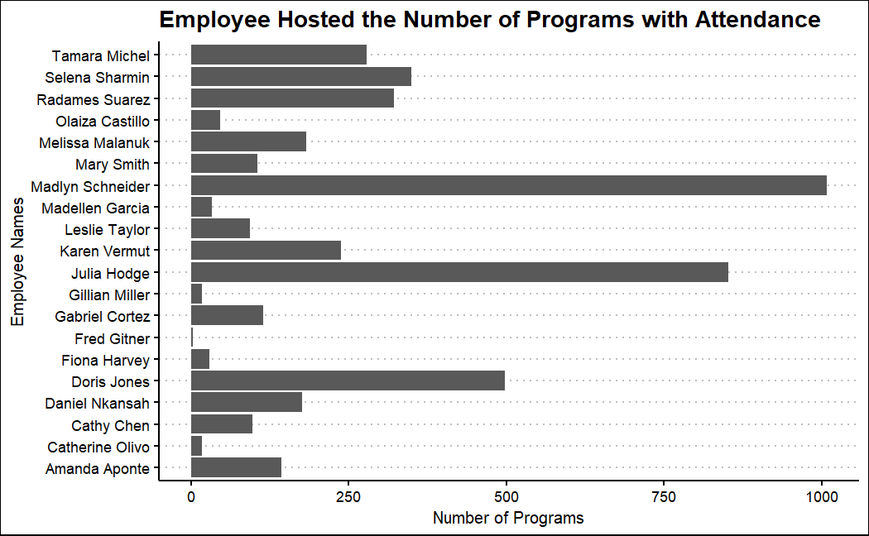
Of the programs with attendance entered- which staff booked the most programs/sessions? The least # of programs/sessions?
The employee that hosted the most programs with attendance is Madlyn Schneider with 1008 programs, and the least is Fred Gitner with 3 programs
Staff Name | Programs with Attendance
Amanda Aponte | 143
Catherine Olivo | 18
Cathy Chen | 97
Daniel Nkansah | 176
Doris Jones | 498
Fiona Harvey | 29
Fred Gitner | 3
Gabriel Cortez | 114
Gillian Miller | 18
Julia Hodge | 852
Karen Vermut | 238
Leslie Taylor | 93
Madellen Garcia | 33
Madlyn Schneider | 1008
Mary Smith | 105
Melissa Malanuk | 183
Olaiza Castillo | 46
Radames Suarez | 322
Selena Sharmin | 349
Tamara Michel | 279

Slide 4
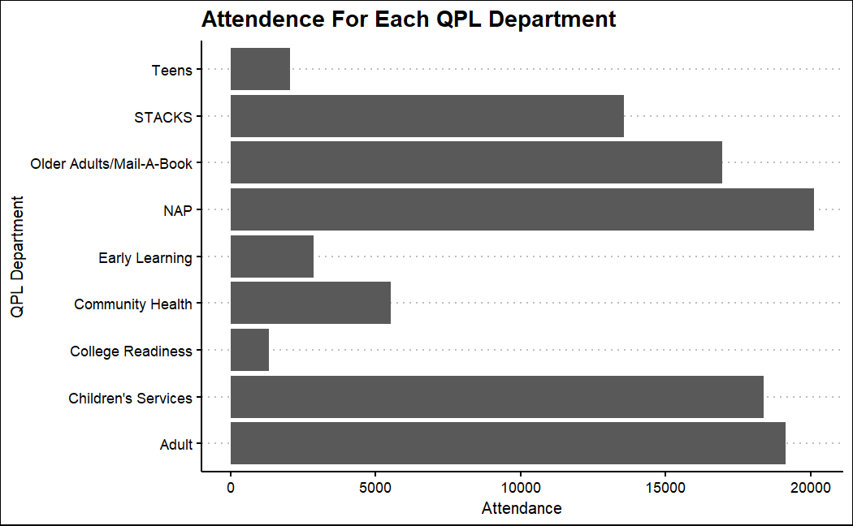
What types of programs were most attended?
The most attended programs were NAP, Adult, Children’s Service, and Older Adults

Slide 5
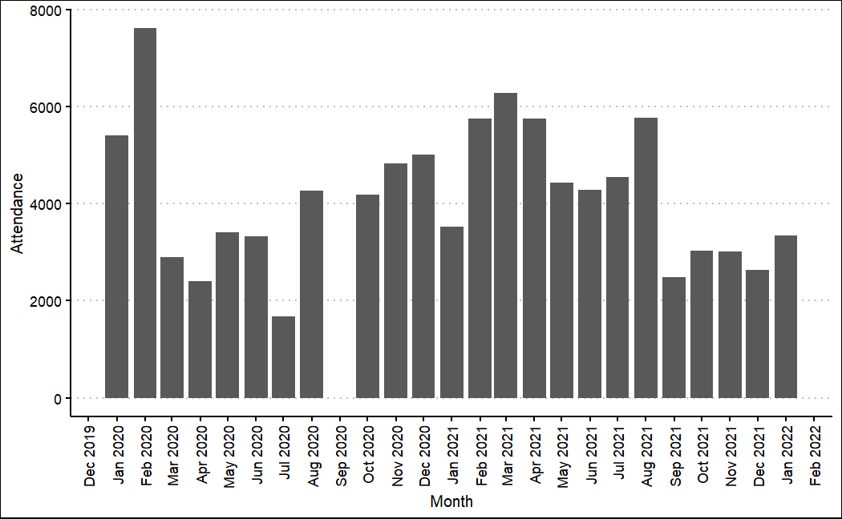
Attendance by Month
The month with the highest attendance is
February 2020 and the month with the
lowest attendance is July 2020.

Slide 6
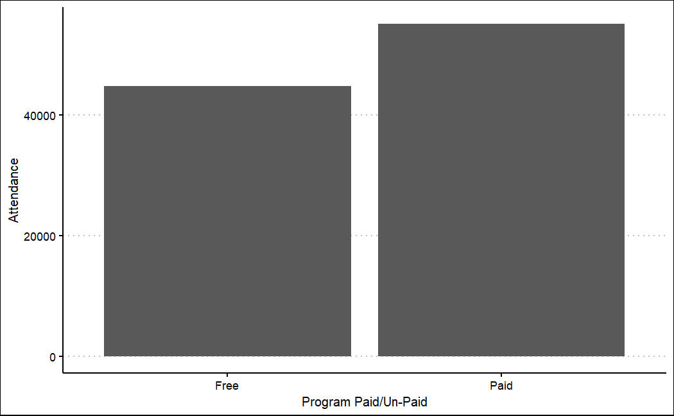
Attendance by Paid or Unpaid Program
Doris Jones has the highest number of programs with zero attendance and the person with the lowest number of programs with no attendance is Fred Gitner

Slide 7
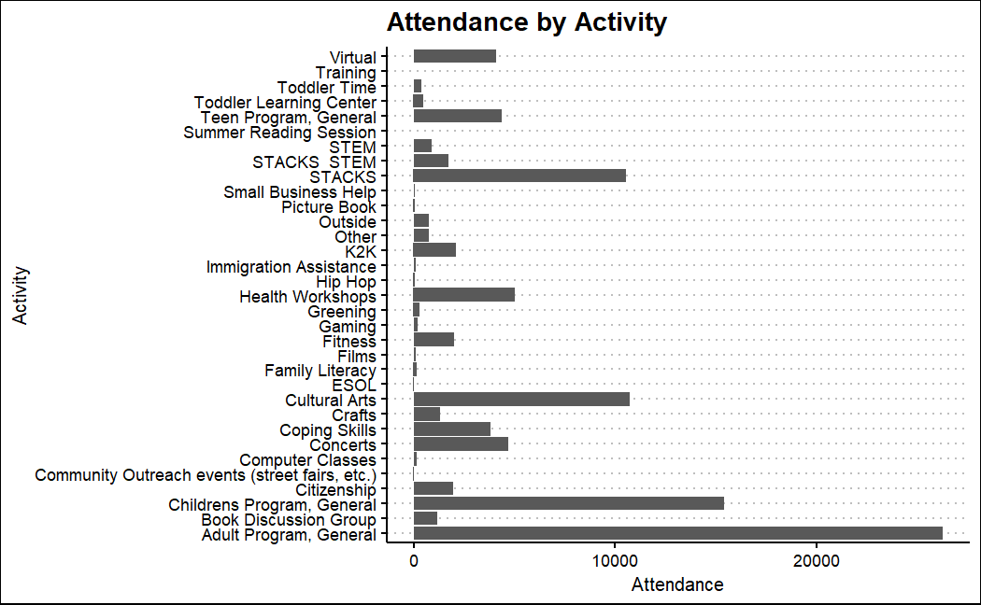
Attendance by Activity
The activity that had the highest attendance by a large margin is the Adult Program, followed by the Children's Program. There are several programs with little or no attendance, such as Summer Reading, ESOL, and Training

